Slide 1
How HOT is FHIR?
Come find out!
Fast, Modern, Implementer-friendly
130+ FHIR-related quarters this week
See the complete list on the wiki:
http://tinyurl.com/fhir201705
Help us plan for FHIR R4
Check out the specification
http://hl7.org/fhir

Slide 2
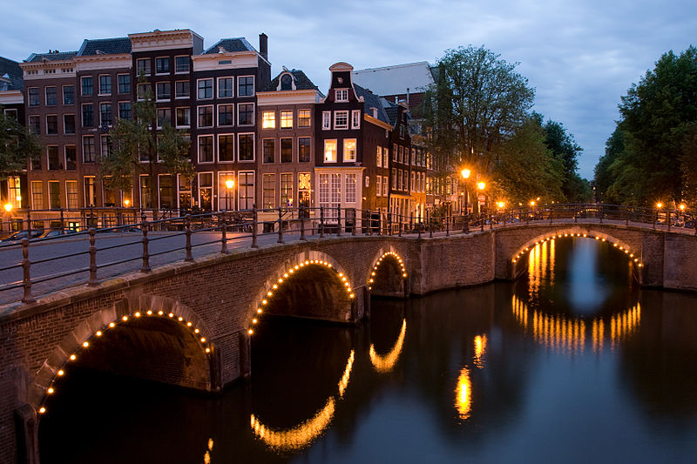






International HL7 FHIR Developer Days November 15-17, 2017 in Amsterdam
(And for the first time in the U.S.: June 19-21, 2018)
Education
12 speakers
16 tutorials/presentations
18 tracks
Connectathon
Meet fellow developers
Put FHIR to the test
Networking
FHIR experts and authors on hand
http://fhir.furore.com/devdays

